Slide 1
LOGIC DESIGN OF
SEQUENTIAL CIRCUITS
Design of Sequential Circuits
Sequential MSI Modules

Slide 2
DESIGN OF SEQUENTIAL CIRCUITS
Design of a Gray Code Counter (Example 4.2)
Problem specification.
For the counter, find state transition table.
Excitation table for the type of chosen FF.
Simplest expressions of excitation signals.
Check the self-correcting property. If not
correct, modify the design.
Implement the counter, then the system.
Example
Design a counter for the given
Gray code subsequence:
000 001 011 010 110 100 000(repeat)

Slide 3
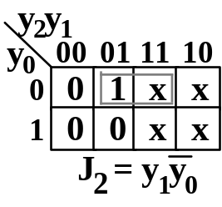
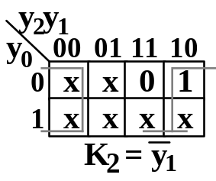
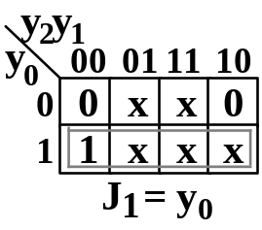
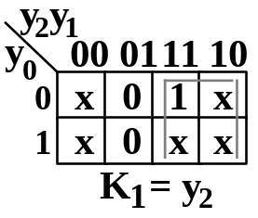
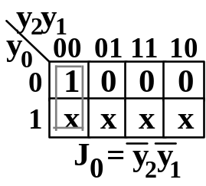
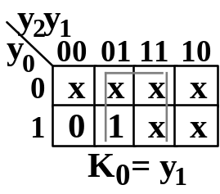
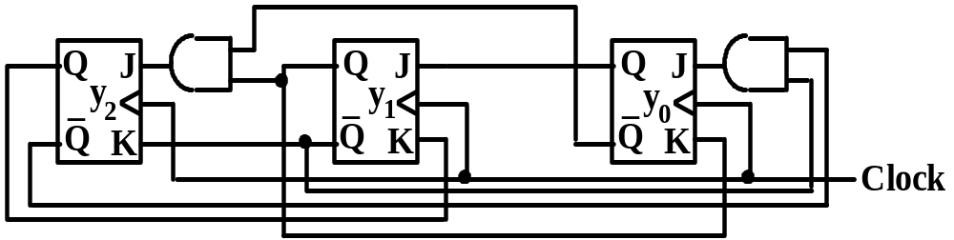
DESIGN OF SEQUENTIAL CIRCUITS (continued)
Design of the counter using JK FF’s
Counting sequence state transition table
State transition table Excitation table
current
next
Excitation for JK FF’s
y₂ y₁ y₀
0 0 0 0 0 1 0 1 0 0 1 1 1 0 0 1 0 1 1 1 0 1 1 1
y₂’ y₁’ y₀’
0 0 1 0 1 1 1 1 0 0 1 0 0 0 0 x x x 1 0 0 x x x
J₂ K₂
0 x 0 x 1 x 0 x x 1 x x x 0 x x
J₁ K₁
0 x 1 x x 0 x 0 0 x x x x 1 x x
J₀ K₀
1 x x 0 0 x x 1 0 x x x 0 x x x
Self-correcting:
101 ->011
111 -> 100

Slide 4
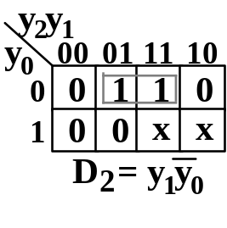
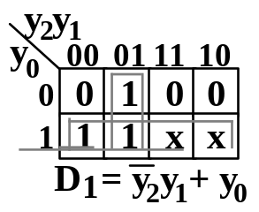
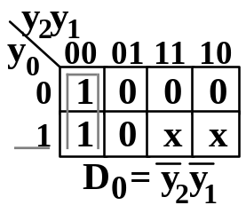
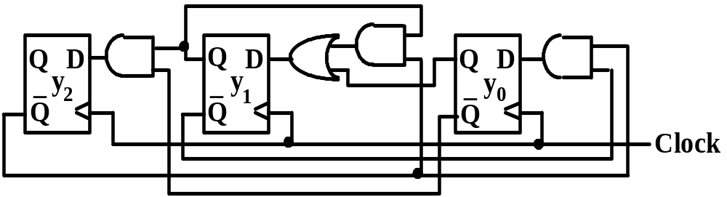
DESIGN OF SEQUENTIAL CIRCUITS (continued)
Design of the counter using D FF’s
State transition table & Excitation table
current
next
Excitation
y₂ y₁ y₀
0 0 0 0 0 1 0 1 0 0 1 1 1 0 0 1 0 1 1 1 0 1 1 1
y₂’ y₁’ y₀’
0 0 1 0 1 1 1 1 0 0 1 0 0 0 0 x x x 1 0 0 x x x
D₂ D₁ D₀
0 0 1 0 1 1 1 1 0 0 1 0 0 0 0 x x x 1 0 0 x x x
Self-correcting:
101 -> 010
111 -> 010

Slide 5


SEQUENTIAL MSI MODULES
Shift Register & Shift Operations
Left shift, e.g., on JK FF’s
Logical right shift, e.g., on D FF’s
Arithmetic right shift: connect MSB to shift in
Arithmetic left shift: signal overflow if the
sign changes.
Rotate: connect shift in & shift out

Slide 6
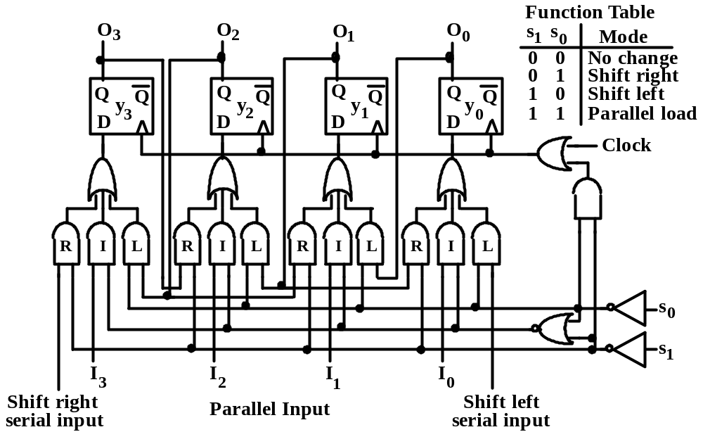
SEQUENTIAL MSI MODULES(continued)
Bidirectional Shift Register
To maintain D FF unaltered, either feedback
Q to D or block the clock.
Use AND or OR gate to block the clock.

Slide 7
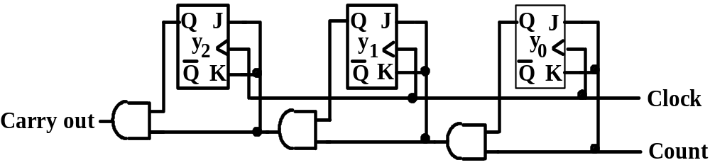
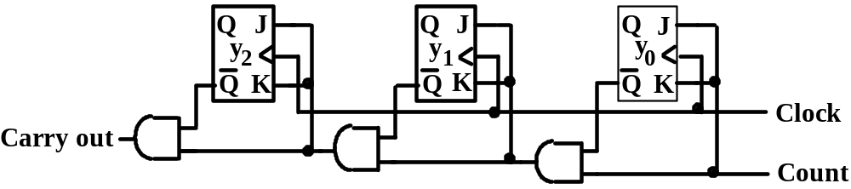
SEQUENTIAL MSI MODULES(continued)
Ripple-Carry Binary Counter
Count up
Count down
Count up
current
next
next
y₀ triggers every clock.
y₁ triggers if y₀=1.
y₂ triggers if y₁y₀=1.
y_{i} triggers if y_{i-1}…y₀=1.
y₂ y₁ y₀
0 0 0 0 0 1 0 1 0 0 1 1 1 0 0 1 0 1 1 1 0 1 1 1
y₂’ y₁’ y₀’
0 0 1 0 1 0 0 1 1 1 0 0 1 0 1 1 1 0 1 1 1 0 0 0
y₂’ y₁’ y₀’
1 1 1 0 0 0 0 0 1 0 1 0 0 1 1 1 0 0 1 0 1 1 1 0
Count down
y₀ triggers every clock.
y₁ triggers if y₀=1.
y₂ triggers if y₁y₀=1.
y_{i} triggers if y_{i-1}…y₀=1.

Slide 8
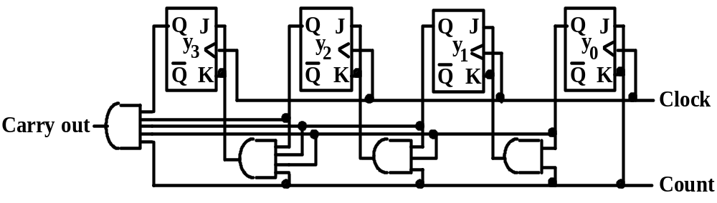
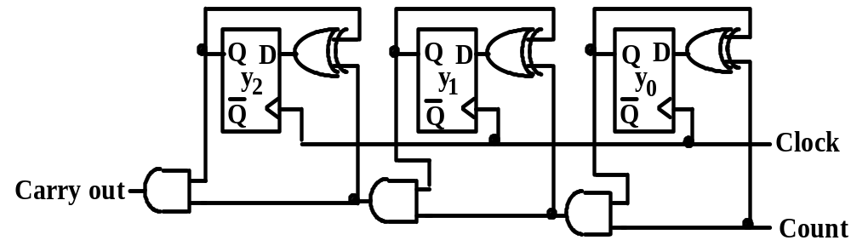
SEQUENTIAL MSI MODULES(continued)
Counter on D FF’s & Parallel Counter
Parallel Counter
Counter on D FF’s

Slide 9
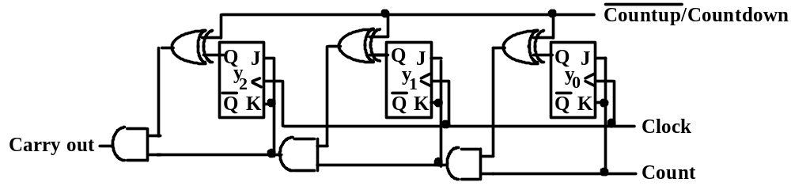
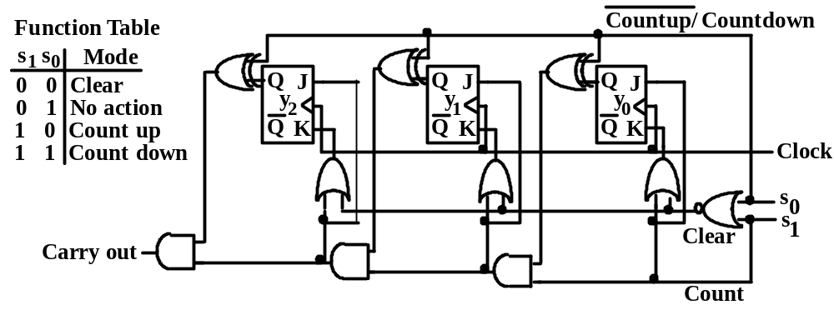
SEQUENTIAL MSI MODULES(continued)
Up/Down Counter
Up/Down Counter selected by XOR gates
Multifunctional Up/Down Counter

